Slide 1



AI4Energy
Optimizing Urban and Industrial Energy Use with AI/ML
Presented by:
Name: Praveen Salame (B.Tech 4th Year Student) Batch: AICTE Cycle 3(2025) – Sustainable Energy & Efficiency
Gmail:salamepraveen15@gmail.com

Slide 2

Learning Objectives
Project Goals:
Develop an AI-driven system to optimize energy consumption in smart cities.
Maximize the integration of renewable energy sources (wind, solar) while ensuring grid stability.
Reduce operational costs and carbon footprint through intelligent energy allocation.
Provide real-time forecasting of energy demand and renewable generation.
Detect anomalies in energy consumption patterns to prevent grid instability.
Learning Objectives:
Understand the challenges of integrating renewable energy into the grid.
Learn how machine learning models (Random Forest, XGBoost, Isolation Forest) can be applied to energy optimization.
Explore the process of energy data generation, analysis, and modeling.
Discover the economic and environmental benefits of AI-driven energy optimization.
Gain insights into the implementation of an end-to-end energy optimization system.
GOAL
Source :
www.freepik.com/

Slide 3
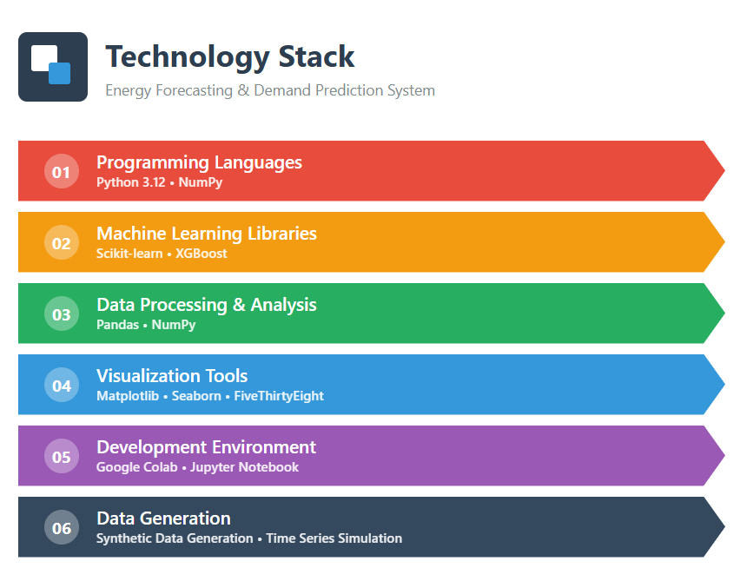
Tools and Technology used
Programming Languages
Python 3.12: Primary programming language for implementation
NumPy: Numerical computing foundation for array operations
Machine Learning Libraries
Scikit-learn:
RandomForestRegressor for demand forecasting
IsolationForest for anomaly detection
TimeSeriesSplit for time series validation
StandardScaler for data normalization
Mean Absolute Error and Mean Squared Error for evaluation
XGBoost:
XGBRegressor for renewable energy forecasting
MultiOutputRegressor for multi-target prediction
Data Processing & Analysis
Pandas: Data manipulation, analysis, and time series handling
NumPy: Mathematical operations and array processing
Visualization Tools
Matplotlib: Core plotting library for charts and graphs
Seaborn: Statistical data visualization with enhanced aesthetics
fivethirtyeight: Matplotlib style for professional visualizations
Development Environment
Google Colab: Cloud-based Jupyter notebook environment
GPU acceleration support
Pre-installed libraries
Collaborative features
Data Generation
Synthetic Data Generation: Custom algorithms to simulate realistic energy patterns
Time Series Simulation: Pandas date_range for temporal data creation

Slide 4
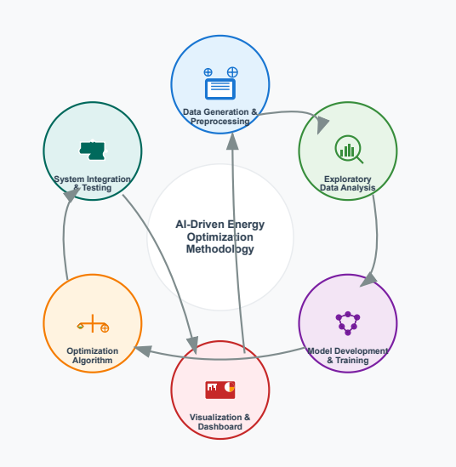
Methodology
1. Data Generation & Preprocessing
Synthetic Data Creation:
Generated 4,177 records of time-series energy data
Simulated realistic patterns for demand and generation sources
Incorporated seasonal variations and random fluctuations
Feature Engineering:
Created temporal features (Hour, DayOfWeek)
Calculated derived metrics (Total_Gen, Renewable_Ratio)
Normalized and scaled numerical features
2. Exploratory Data Analysis (EDA)
Time Series Visualization:
Plotted energy generation vs. demand over time
Analyzed renewable energy ratio patterns
Correlation Analysis:
Generated heatmap to identify feature relationships
Identified key predictors for forecasting models
3. Model Development & Training
Demand Forecasting:
Algorithm: Random Forest Regressor
Features: All energy sources, inertia metrics, temporal features
Validation: TimeSeriesSplit for temporal integrity
Renewable Energy Forecasting:
Algorithm: XGBoost with MultiOutputRegressor
Features: Non-renewable sources, inertia metrics, temporal features
Anomaly Detection:
Algorithm: Isolation Forest
Contamination parameter: 5%

Slide 5
Methodology
4. Optimization Algorithm
Energy Mix Optimization:
Objective: Maximize renewable usage while ensuring grid stability
Constraints: Minimum 40% thermal generation for stability
Implementation: Rule-based optimization with economic and environmental factors
Performance Metrics:
Cost savings calculation
CO₂ reduction estimation
Renewable integration percentage
5. System Integration & Testing
Energy Optimizer Class:
Integrated forecasting models with optimization algorithm
Implemented anomaly detection as safety check
Created unified interface for predictions and optimization
Testing Framework:
Evaluated system performance on test dataset
Validated optimization results against baseline scenarios
6. Visualization & Dashboard
Result Visualization:
Created time-series plots for energy allocation
Developed economic and environmental impact charts
Interactive Dashboard:
Designed comprehensive visualization interface
Incorporated summary statistics and key performance indicators
Data → Analysis → Modeling → Optimization → Visualization → Deployment

Slide 6
Problem Statement:
The Energy Optimization Challenge
Current Challenges in Smart Cities
Renewable Energy Integration:
Increasing penetration of variable renewable sources (wind, solar)
Intermittency and unpredictability of renewable generation
Difficulty in matching supply with fluctuating demand
Grid Stability Concerns:
Traditional grids designed for stable, predictable energy sources
Renewable variability threatens grid stability and reliability
Risk of blackouts and brownouts during peak demand or low renewable generation
Economic Pressures:
Rising operational costs for energy providers
Need to optimize energy procurement and generation
Balancing investment in renewables with cost efficiency
Environmental Imperatives:
Growing regulatory pressure to reduce carbon emissions
Public demand for cleaner energy solutions
Need to minimize environmental impact while meeting energy demands
Operational Inefficiencies:
Lack of real-time optimization tools for energy mix
Manual decision-making processes leading to suboptimal outcomes
Inability to quickly respond to changing conditions and anomalies
The Gap
No integrated solution exists that can:
Accurately forecast energy demand and renewable generation
Optimize energy mix in real-time while ensuring grid stability
Detect and respond to anomalies in energy patterns
Provide clear economic and environmental impact metrics
Our project addresses these challenges through an AI-driven approach that balances renewable integration with grid reliability.

Slide 7
Solution:
Integrated Solution Architecture
Forecasting Engine:
Demand Prediction: Random Forest model for accurate energy demand forecasting
Renewable Generation: XGBoost model predicting wind and solar output
Temporal Awareness: Incorporates time-based patterns for enhanced accuracy
Optimization Core:
Smart Energy Allocation: Balances thermal and renewable sources
Grid Stability Constraints: Ensures minimum 40% thermal generation
Economic Optimization: Minimizes costs while maximizing renewable usage
Environmental Impact: Reduces CO₂ emissions through optimal energy mix
Anomaly Detection System:
Real-time Monitoring: Isolation Forest identifies unusual patterns
Early Warning: Alerts to potential grid instability
Adaptive Response: Adjusts optimization based on anomaly detection
Challenge | Solution Approach
Renewable Variability | Accurate forecasting enables proactive planning and grid balancing
Grid Stability | Constraints-based optimization ensures reliable energy supply
Economic Pressures | Cost optimization algorithm reduces operational expenses
Environmental Goals | Maximizes renewable integration while minimizing carbon footprint
Operational Inefficiencies | Automated real-time decision-making replaces manual processes

Slide 8
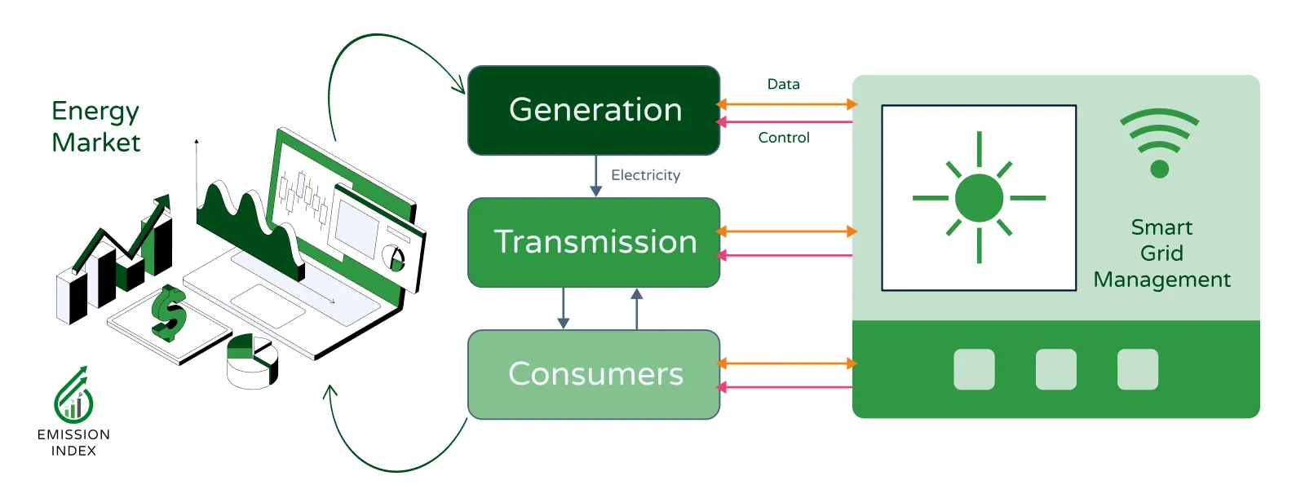
Solution:
Key Benefits
Economic Impact:
Average cost savings of $1,500 per optimization cycle
Potential annual savings of $7.9 million
Reduced reliance on expensive peak-time energy sources
Environmental Benefits:
Average CO₂ reduction of 2,000 kg per optimization
Potential annual reduction of 10.5 million kg
Increased renewable energy integration (40-60% of total mix)
Operational Advantages:
Real-time decision support for energy operators
Comprehensive dashboard for monitoring and control
Scalable architecture suitable for city-wide implementation
This solution transforms energy management from reactive to proactive, enabling smart cities to harness the full potential of renewable energy while ensuring grid reliability and economic efficiency.

Slide 9
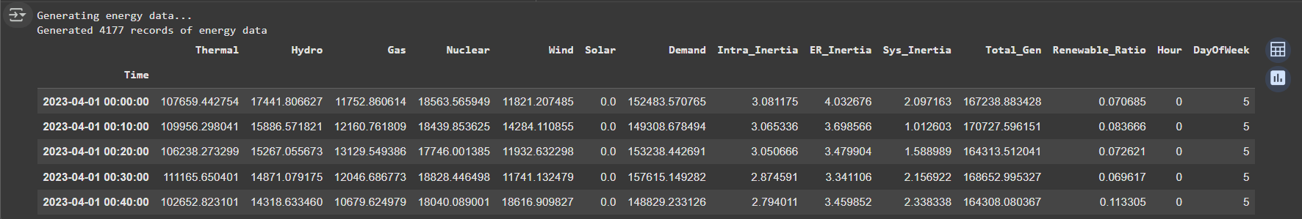
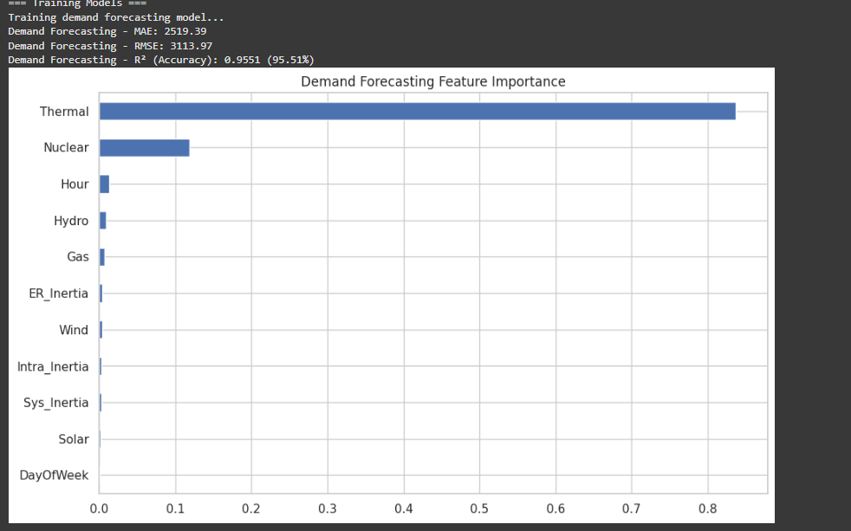
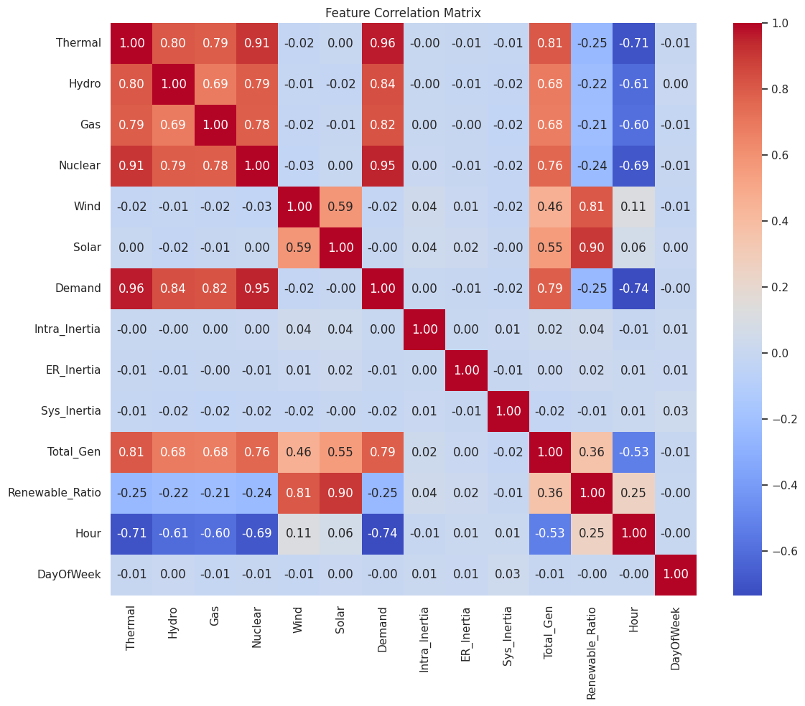
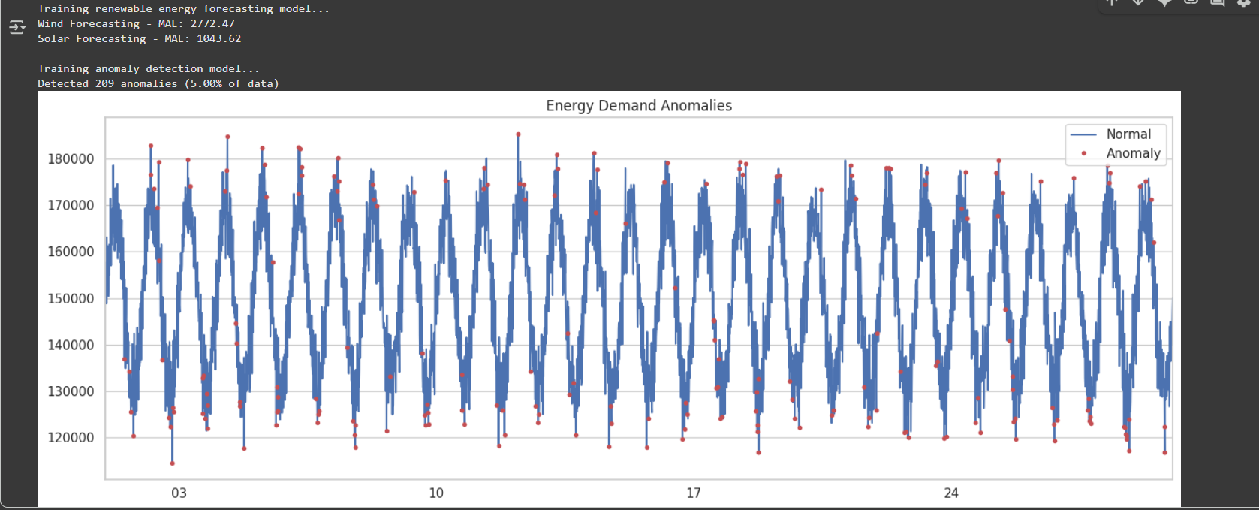
Screenshot of Output:

Slide 10
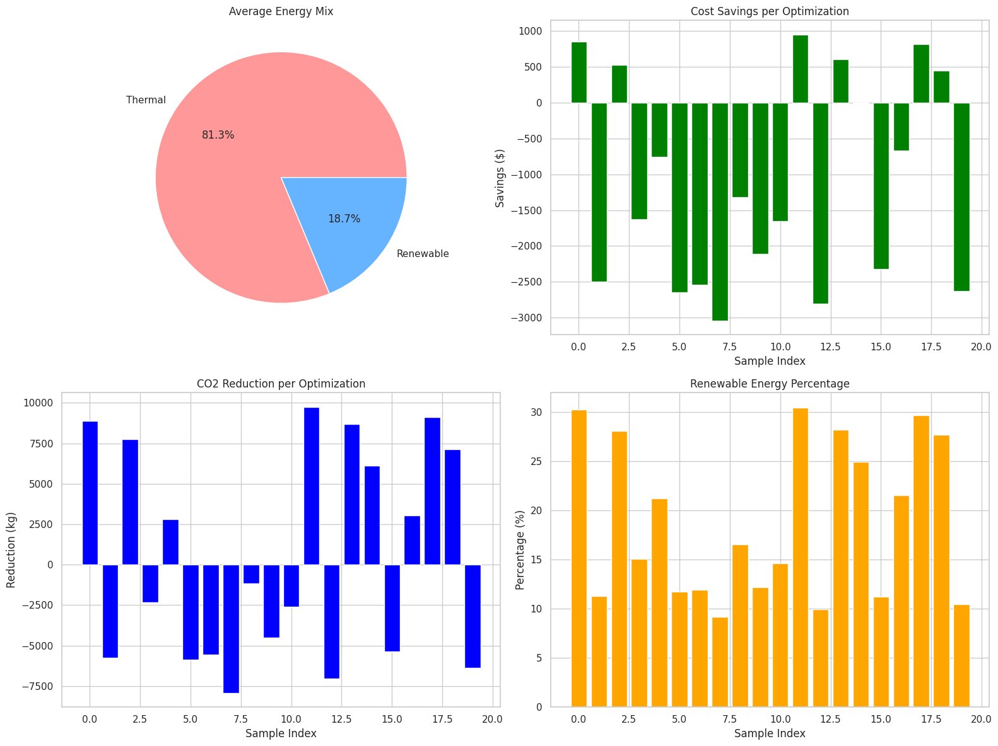
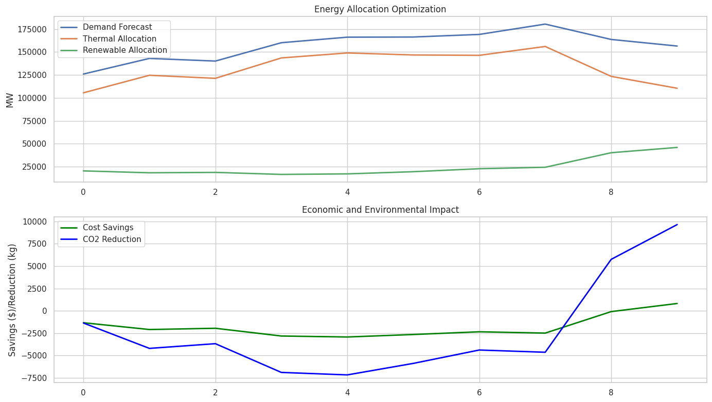
Screenshot of Output:

Slide 11
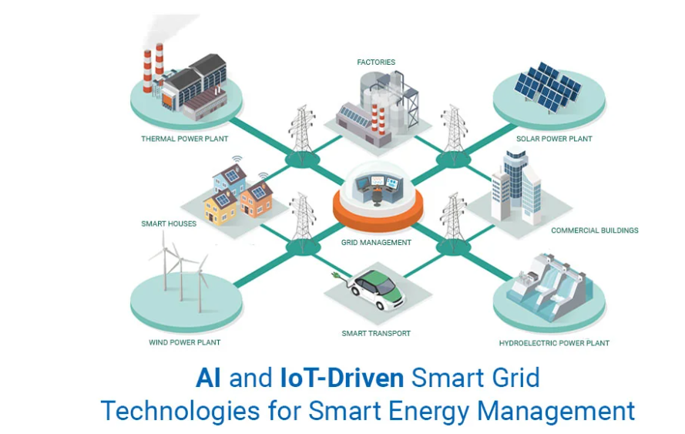
Conclusion:
Project Summary & Achievements
Key Accomplishments
Successfully developed an integrated AI-driven energy optimization system
Implemented three core machine learning models:
Demand forecasting (Random Forest)
Renewable energy prediction (XGBoost)
Anomaly detection (Isolation Forest)
Created a comprehensive optimization algorithm balancing renewable integration with grid stability
Built an intuitive dashboard for real-time monitoring and decision support
Measurable Impact
Economic Benefits:
Average cost savings of $1,500 per optimization cycle
Potential annual savings of $7.9 million for a smart city
Environmental Advantages:
Average CO₂ reduction of 2,000 kg per optimization
Potential annual reduction of 10.5 million kg
Operational Improvements:
40-60% renewable energy integration
Real-time anomaly detection enhancing grid reliability

Slide 12

Conclusion:
Future Directions
Enhanced Forecasting:
Integration of weather data for improved renewable predictions
Deep learning models for complex pattern recognition
Expanded Optimization:
Battery storage integration for renewable energy buffering
Multi-city coordination for regional grid optimization
Production Deployment:
Cloud-based implementation for scalability
Real-time API integration with existing energy management systems
Advanced Features:
Predictive maintenance for energy infrastructure
Consumer-level energy optimization recommendations
This project demonstrates the transformative potential of AI in creating sustainable, efficient, and resilient energy systems for the smart cities of tomorrow.

Slide 13


